Slide 1
Microservices and DevOps
DevOps and Container Technology
Distributed Computing
Henrik Bærbak Christensen

Slide 2
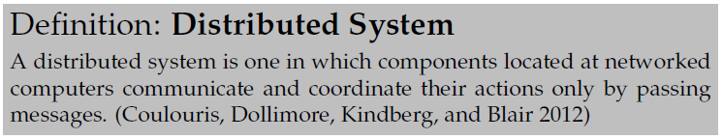
Distributed System
Why?
  To speed up computation
    Google search, and a few other cases
  To share information
    Everything else! (Slight exaggeration!)

Slide 3
A MultiStage Approach
This whole fagpakke is a basically about distributed systems
  (Part of the definition of Microservices)
We will approach it in stages
  The Basics send and receive network package
  Broker Pattern Object Oriented Style
  REST Data/Resource centric Style
  Microservices Well…
  Arch. Qualities Availability, Testability, Scalability…

Slide 4
“Limitation”
We will stay in an important ”niche”
Client-server Architectures using Remote Procedure Call
… this niche covers quite a few systems in practice ☺

Slide 5
Security
Distributed systems means Security…
  There may be actors whose intentions are not good ☹
Architecturally, security is quite a pain in our context…
  Because security techniques are one big set of hard bindings and strong coupling
    You need certificates that tie you to a specific DNS name
      Certificate stores, key pair generation, trust chains, yaga yaga
We will cover standard techniques but…
  Likely disable it quite a lot
  Not cover more specialized techniques

Slide 6
The History
Birrell and Nelson, 1984:
  “allow calling procedure on remote machines”
  A calls procedure f on B means
    A suspends, information on f is transmitted to B
    B executes the f procedure
    B sends the result back to A
    A resumes

Slide 7
Initial Glimpse
SkyCave

Slide 8
Case Study: SkyCave
SkyCave is a
  Massive multi-user online, exploration and creation experience with a bit of social networking
  … with a horrible user interface
  … and high disregards for security
    Learn that somewhere else…
Inspired by the very first ‘interactive fiction’ game for a computer: Colossal Cave Adventure
  Will Crowder, 1972
    I played my first game in 1986

Slide 9
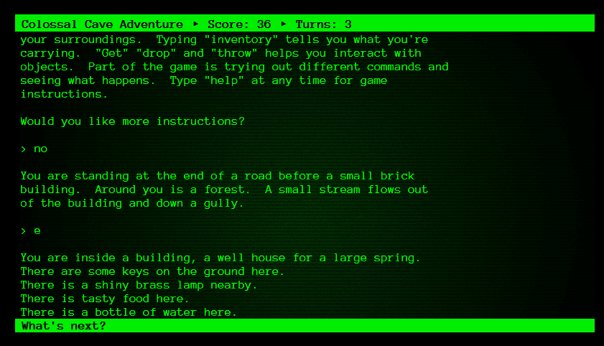
The History

Slide 10
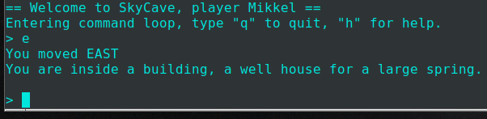
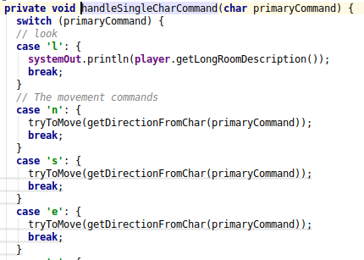
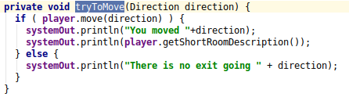
So: Let the player move east…
Broker: Let a ‘player.move(d)’ method on the client side be ”transparently” translated into a ‘player.move(d)’ on the server side…

Slide 11
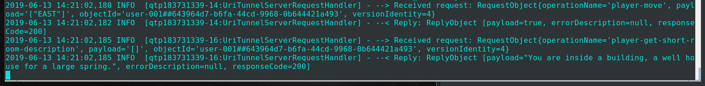
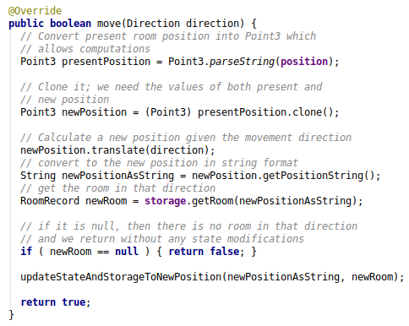

On the Server Side

Slide 12
Issues in Distribution
Why is it hard?

Slide 13
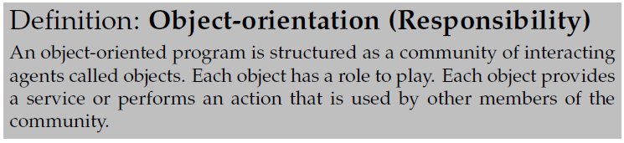
Challenge
How guys like me like to code:
Which is then something like:

Slide 14
Challenge
However - networks only support two asynch functions!
Which is not exactly the same as

Slide 15
Issues (at least!)
Send/receive is a too low level a programming model
Send() does not wait for a reply from server (Asynch)
Reference to object on my machine does not make sense on remote computer (memory address)
Networks does not transfer objects, just bits
Networks are slow
Networks and Remote computers may fail
Networks are insecure, others may pick up our data
Security QA
Availability QA
Performance QA

Slide 16
Performance
Just how much slower is a network call compared to a local in-JVM memory call?
Imagine that your next trip to the supermarket for a soda was 275 times slower???
  10 minutes walk versus 46,8 hours walking ☺

Slide 17
Elements of a Solution
On the ‘happy path’, we need to
  Make the client invoke a synchronous method call on a remote player object using only network send/receive
    That is, the client blocks until server has returned reply
  Keep our OO programming model: player.move(‘east’);
    That is invoke specific method on specific remote object
  Convert method call and parameters into bits to send it, and convert it back again
    That is, convert Enum/Object/Array into bits and back again
  Locate the remote right player object
    That is, invoke method on object Mikkel, not object Magnus !

Slide 18
Elements Overview
Solutions are
  Request/Reply Protocol
    Simulate synchronous call (solves (partly) concurrency issue)
  Marshalling
    Packing objects into bits and back (solves data issue)
  Proxy Pattern (and Broker pattern)
    Simulate method call on client (solves programming model issue)
  Naming Services
    Use a registry/name service (solves remote location issue)

Slide 19
Request/Reply

Slide 20
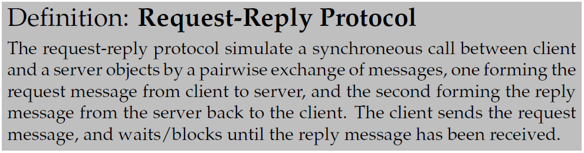
The Protocol
Known from every WWW access you have ever made…

Slide 21
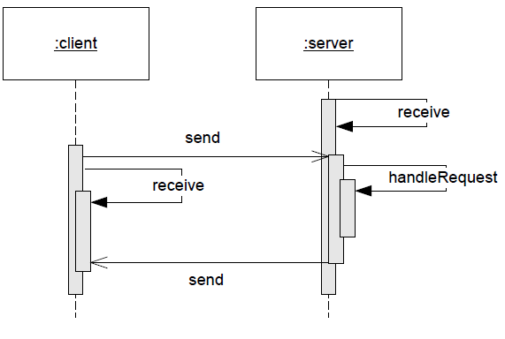
Pairing Send/Receives
Client does
  Send() and
  receive
Server does
  Receive() and
  send()
Roles
  Client is active – initiate action
  Server is reactive – awaits actions and then reacts

Slide 22
Marshalling
Or Serialization

Slide 23
Definitions

Slide 24
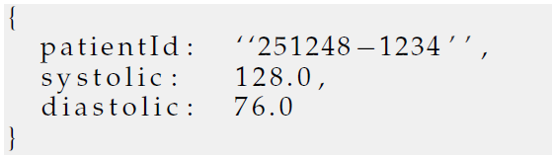
Two Basic Approaches
There are two approaches
  Binary formats
    Google ProtoBuf, propriatary
  Textual formats
    XML, JSON, propriatary
Exercise: Costs? Benefits?
JSON blood pressure

Slide 25
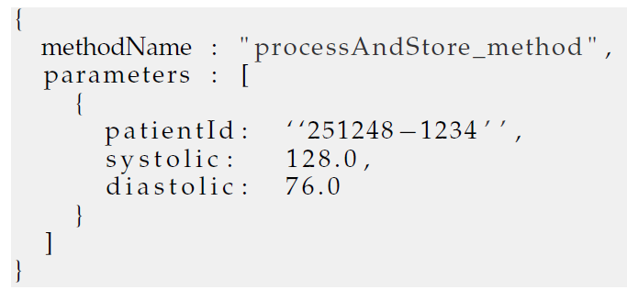
And we need more
As we can send only bits, we also need to marshal information about the method and object id!

Slide 26
Note
Marshalling is fine for atomic datatypes (int, String, double, array, …) but…
What about object references?
  inventory.addCustomer(c) where c is Customer object?
Java RMI can do such things, but it is complex
  Naming schemes, registries of implementing classes, dynamic class loading, …
FRDS.Broker only support server hold references
  I.e. a server never calls an object on a client! ClientServer!!!

Slide 27
The Details
Pass by reference
  The Java style for all objects
  You do not get the ”Hello” string, you get a reference to it!
  public void say(String s);
Pass by value
  Java does this for primitive types, like int and double
  You do get the value itself
  public void deposit(double amount);

Slide 28

In C and C++
In C and C++ you can actually do both
  If the first call adds 10 to value, what happens to value at the call site?
    int v = 7; fooByValue(v); print(v);
  If the second call adds 10 to value, what happens to value at the call site?
    int v = 7; fooByRef(&v); print(v);

Slide 29
In Our Broker
The semantics change in our Broker Pattern
  localObject.say(”Hello”) localObject pass by reference
  remoteObject.say(”Hello”) remoteObject pass by value
Exercise: Why?
Our Broker only supports pass by value!
Server objects are pass by ID.
Notes:
If we pass references, then our server may begin to call methods on the object on our client! Not client-server! And scales terribly!

Slide 30
JSON Libraries

Slide 31
Libraries
Every distributed system in the world needs to marshall!
Thus – lots of marshalling libraries around ☺
  Do NOT do it yourself!!!
    String json = ”{ name: ”+ object.name+ ”}…
JSON I have used many libraries
  Json-simple
  Jackson JSON
  Gson

Slide 32
Gson
Gson is the most compact I have used
  (But have had trouble with ‘date’ objects that marshalls incorrectly!)
It allows easy marshalling of record types
  Also known as
    PODO: Plain Old Data Objects,
    DTO: Data Transfer Object
Record type (Pascal) / ‘struct’ (C) / ”bean” (java)
  No complex methods, only set/get methods with no side effects
  Must have a default constructor
That is: A pure data object, just storing information
  Akin a ‘resource’ in REST terminology, by the way

Slide 33
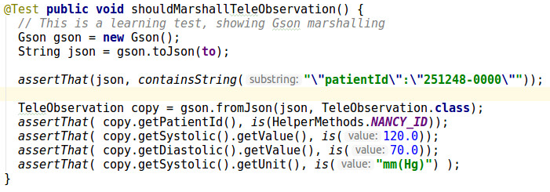
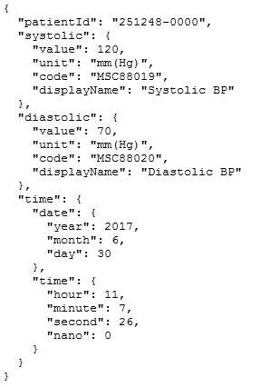
Example:
toJson(obj)
  Marshall
fromJson(str, type.class)
  Demarshall, using given type

Slide 34
Proxy

Slide 35
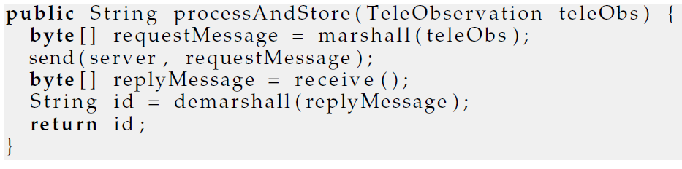
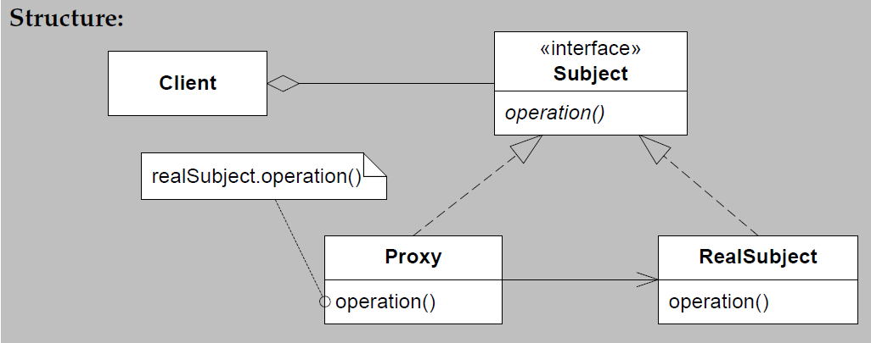
Example
TeleMedProxy
Client
Server
Network
call

Slide 36
Note
The algorithm of all methods in the proxy will be the same
  Marshall parameters, send, await reply, demarshall, return
Can be auto generated – this is what RMI does
We will hand-code it, because
  It actually makes sense if you want very strict control of architectural attributes like availability, testability, performance
    Which are major learning goals in this course

Slide 37
Why QAs
Why? One Example:
You have a lot of accessor methods, and a single mutator
  i.e. state only changes when mutator is invoked!
RMI will autogenerate proxy (send/receive) for every method
That is, every accessor method call will generate network traffic!
Performance Antipattern: Chatty interface
Pattern: Chunky interface
  All accessors just return cached state in the proxy instance itself!

Slide 38
Name Services

Slide 39

Name Services
If I do not know, I know someone who does…
  If I do not know the telephone number of X, I know someone who does
    Old days: Telephone book
    More modern days: krak.dk, linked in, facebook, whatever
DNS: Domain Name Servers

Slide 40
Name Services
Name Services are actually just a fancy name for a Map<Key, Value> data structure which allows me to associate a name/key with an object
  DNS: I have ‘www.imhotep.dk’ as key, please give me the IP address of the associated computer
  RMI Registry: I have this name ‘/sensor/temperature/47’, please give me a remote reference so I can talk with the remote object
These are server based solutions
  You contact a server that keeps the (key,value) database

Slide 41
Local Name Services
For a single server system, you do not need an external name service, you can keep the (key,value) in the (memory of) the server
E.g SkyCave does just keep a (playerId, player) mapping at hand…
  Any upcall of a player method, will lookup in the name service, retrieve the player object, and do the method call on that particular object.
  Exercise: Liabilities
    Hint: Horizontal scaling?

Slide 42
Summary
The Broker Pattern combines
  Request/Reply protocol
  Marshalling
  Proxy pattern
  Naming Systems
… to produce something that (on happy days)
Allows an Object Oriented Programming model to apply to distributed computing

